Slide 1
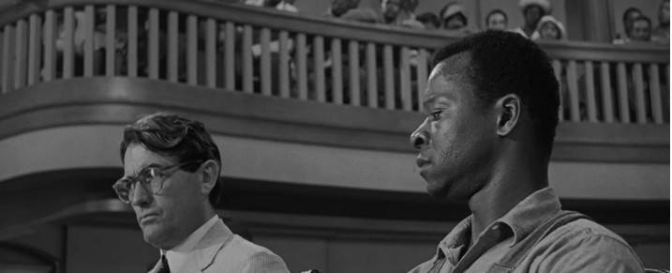
TEACHER TUTORIAL:
Understanding Composition
PowerPoint Presentation
Featuring movie stills from To Kill a Mockingbird
(1962, directed by Robert Mulligan)

Slide 2
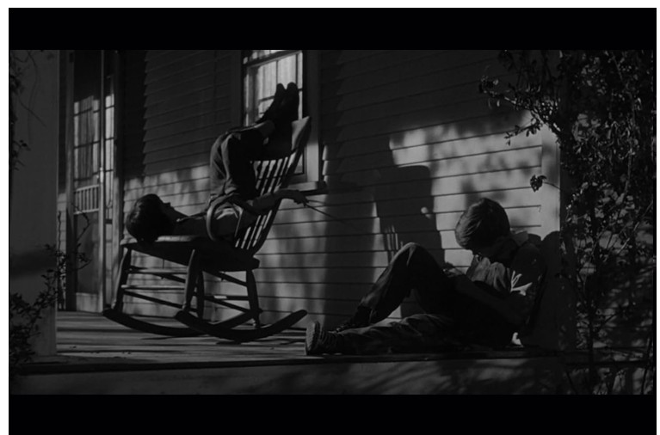
[Young people] need to know how ideas and emotions are expressed through a visual form. We have to begin to teach younger people how to use this very powerful tool...because we know the image can be so strong, not only for good use, but for bad use. Film is very powerful—images are very powerful—and we need to teach younger people how to use them....and interpret them.
— Martin Scorsese

Slide 3
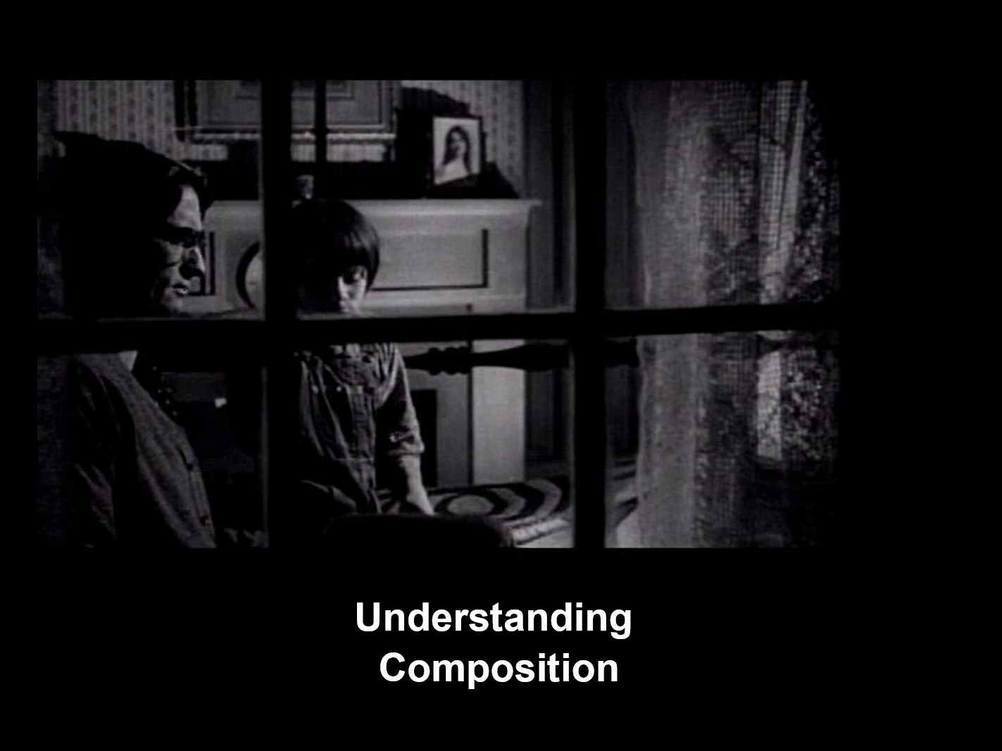

Slide 4
Three Basic Elements of Film Composition
Arrangement of visual elements
Camera distances and angles
Light
intensity and direction

Slide 5
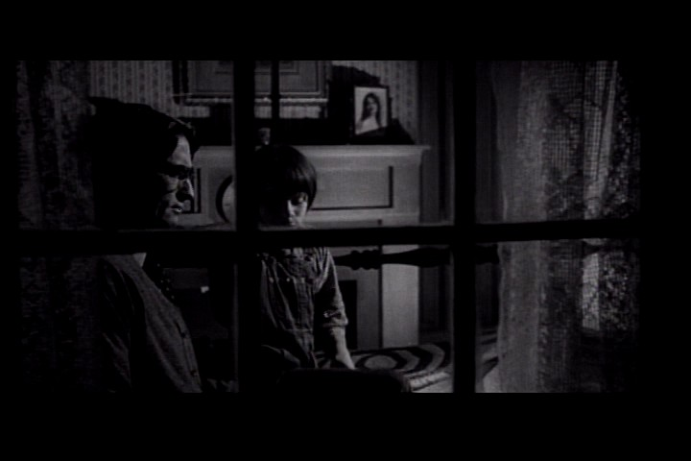
CONCEPT: The frame is a single photograph on a strip of motion-picture film. Composition is the spatial arrangement of all the elements within the frame. The relationship of these elements to one another suggests meaning.
INTERPRETATION: Scout’s position next to her father emphasizes their close relationship. The portrait on the mantle is also significant—the woman is the wife and mother who has died. By including her picture in the composition, the viewer can infer that she is not forgotten.

Slide 6
CONCEPT: The focal point is the element or elements within the frame that the director wants the viewer to notice. Within a single frame, there can be one or more focal points, depending on the composition.
INTERPRETATION: The camera placement outside the window looking in creates six panels. The upper middle panel emphasizes both Scout and the portrait of her mother, linking them.

Slide 7
CONCEPT: Lighting affects what we see—or do not see—and how we see it. This, in turn, determines how the audience may feel about the characters or the situations on the screen.
INTERPRETATION: In this composition, light and shadow both reveal some details and obscure others. Atticus is mostly in shadow, as is Scout—but a little less so. The brighter light is on the fireplace and the portrait. This contrast draws the viewer’s eye to those details.

Slide 8
CONCEPT: Deciding where to place the camera in relation to the subject is another critical element of composition. Like the use of lighting, camera distances and angles control what the audience sees and how they see it.
INTERPRETATION: Although placed outside the window, the camera placement is close enough to see specific details. The placement is also on level with the characters and engages the viewer in the action.

Slide 9
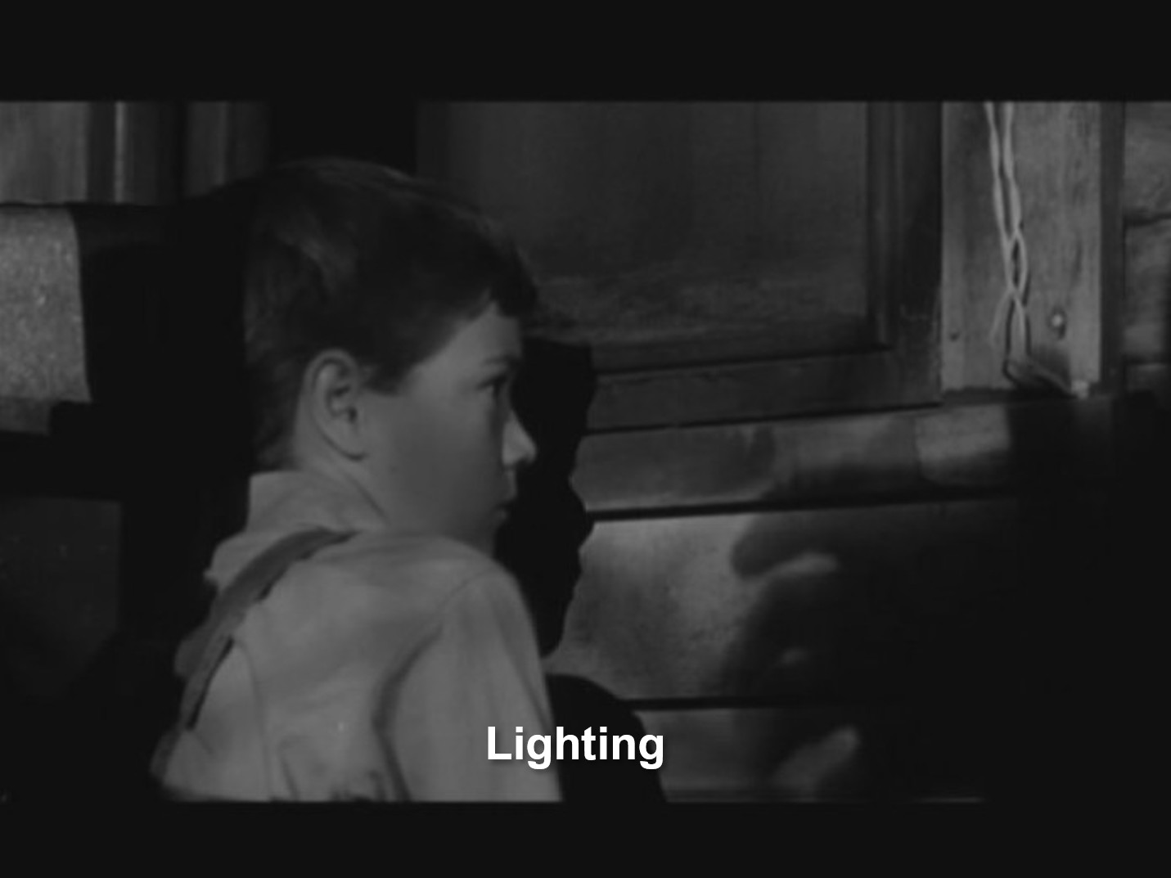

Slide 10
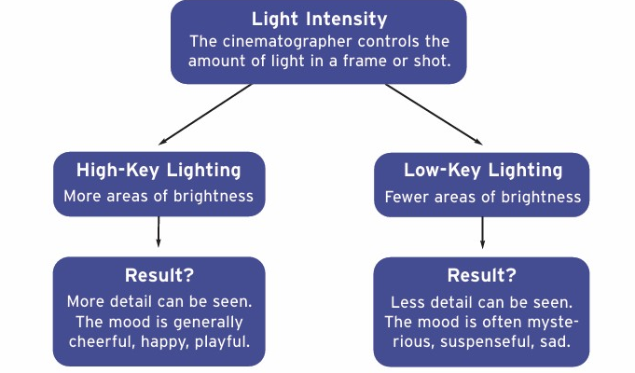
What Is Light Intensity?
CONCEPT: Light is a critical element in composition. Light draws attention to key, or principal, areas within a frame. High intensity light can make visible important details within the frame and suggest realism. Lower intensity light can produce shadows that conceal details and create mood.

Slide 11
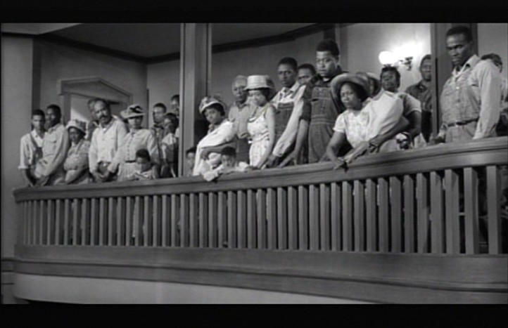
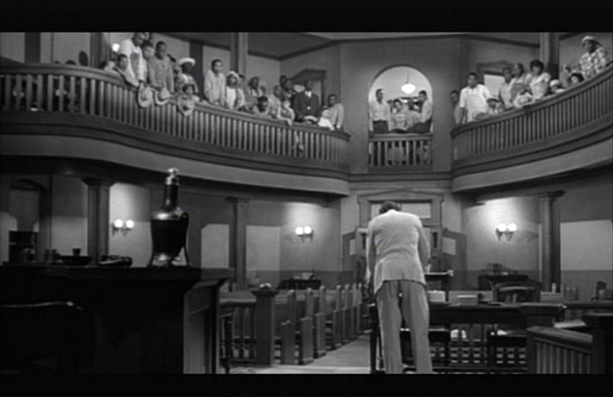
High-Key Lighting
CONCEPT: Key means principal or primary. High-key lighting results in a brightly lit shot in which more visual detail is seen.
INTERPRETATION: In the left frame, the bright light allows the viewer to see the spectators in the balcony. They stand to honor Atticus for defending Tom Robinson. In the right frame, bright light shows details of the courtroom and emphasizes the emptiness of the lower floor while the spectators in the balcony remain.

Slide 12
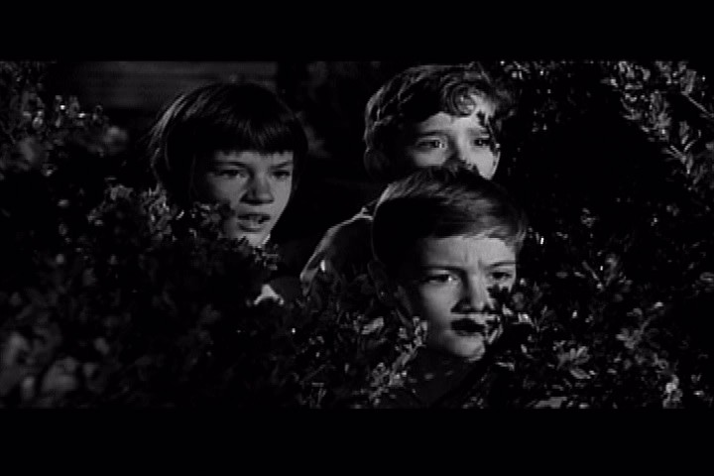
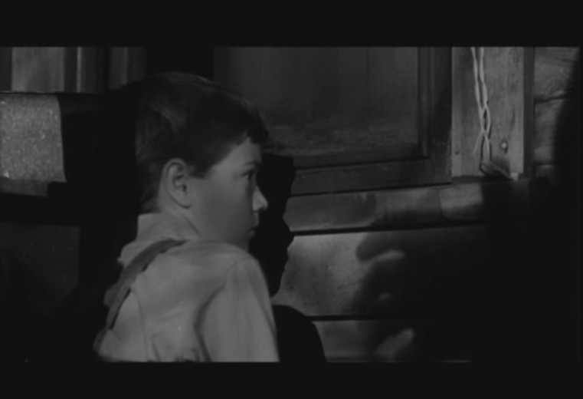
Low-Key Lighting
CONCEPT: The use of low-key lighting conceals some visual details. This style of lighting creates contrast which, in turn, directs the eye to the focal point within the frame.
INTERPRETATION: In the left frame, the children spy on Boo Radley’s house at night. The use of low-key light creates a contrast so that the focal point is their expressions, allowing the audience to intuit what they may be thinking or feeling. In the right frame, the low-key lighting emphasizes the shadow that appears to be a hand reaching to grab Jem.

Slide 13
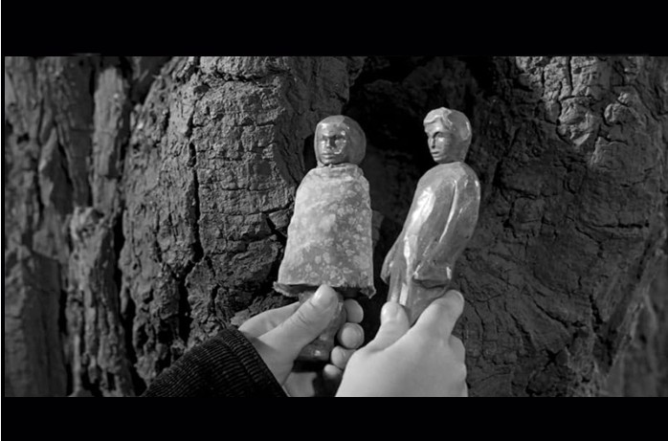
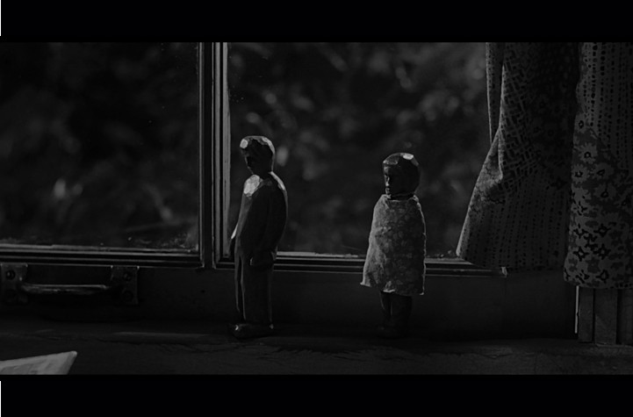
High-Key, Low-Key Lighting
CONCEPT: The use of light affects what we see—or do not see—and how we see it. This, in turn, determines how the viewer may feel about the characters or the situations. Even the same subject when viewed in different light can alter the viewer’s perception.
INTERPRETATION: In the left frame, high-key lighting allows the viewer to see that the carved dolls are a girl and a boy, suggesting they might be Scout and Jem. In the right frame, the same dolls are in deep shadow. This low-key lighting contributes to the mystery surrounding Boo Radley. The placement of the dolls on the bedroom windowsill emphasizes Jem and Scout’s ongoing curiosity about Boo.

Slide 14
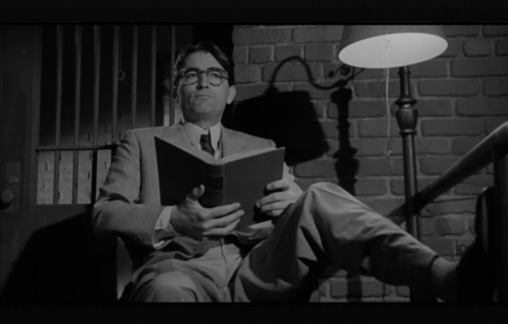
Light Direction
CONCEPT: The angle of light is determined by where the light source is placed. Backlighting, for example, can minimize shadows or, if bright enough, can create a silhouette. Placing the light source below the subject creates a different type of shadow. Placing the light source on either side of the subject likewise creates a different shadow effect.

Slide 15
Light Direction
INTERPRETATION: The primary light source is to the right. Note the shadow of the
lamp and Atticus’s chair on the jail wall. Front lighting on Atticus reveals visual details. Additionally, the light beyond the bars suggests the interior of the jail.

Slide 16
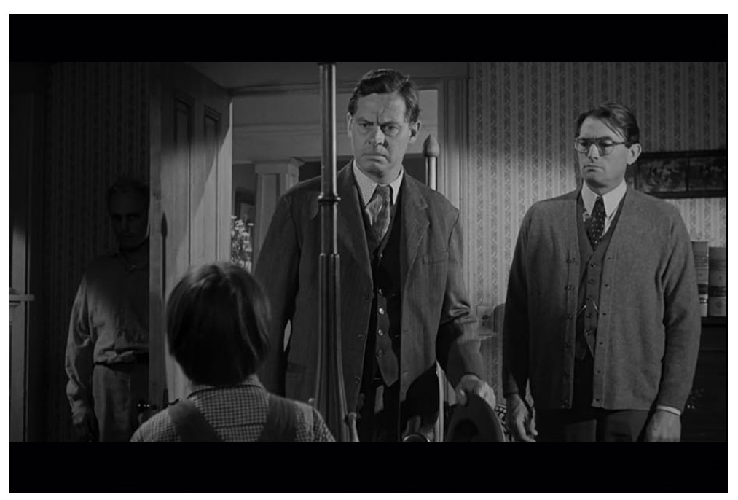
Light Direction
CONCEPT: The use of light affects what we see—or do not see—and how we see it. This, in turn, determines how the audience may feel about the characters or the situations on the screen.
INTERPRETATION. The three characters are framed using front lighting. But a faint beam of side lighting falls across the lower left portion of the frame, allowing the viewer to see Boo Radley standing behind the door.

Slide 17
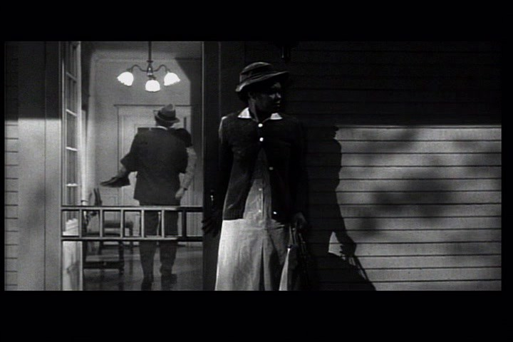
Depth
Depth is the illusion of distance. A cinematographer creates depth in a variety of ways: using lines to suggest distance, using lighting that casts shadows, and/or placing objects or people in the foreground, mid-ground, or background of a frame.
Movement can also create depth. In the frame below, as Atticus carries Scout to bed, he moves from mid-frame to background.

Slide 18
Texture
Texture is what something feels like when touched. Because a movie frame is two-dimensional, texture is suggested through visual design. The graininess of an image creates patterns and shapes that give the illusion of a variety of textures.
INTERPRETATION. In the frame below, both the clapboards and the shadows create textures different from the fabric of Cal’s skirt. The screen door likewise creates a fuzzy graininess that is textural. The hall light draws the eye away from Cal to Atticus carrying Scout to bed.

Slide 19
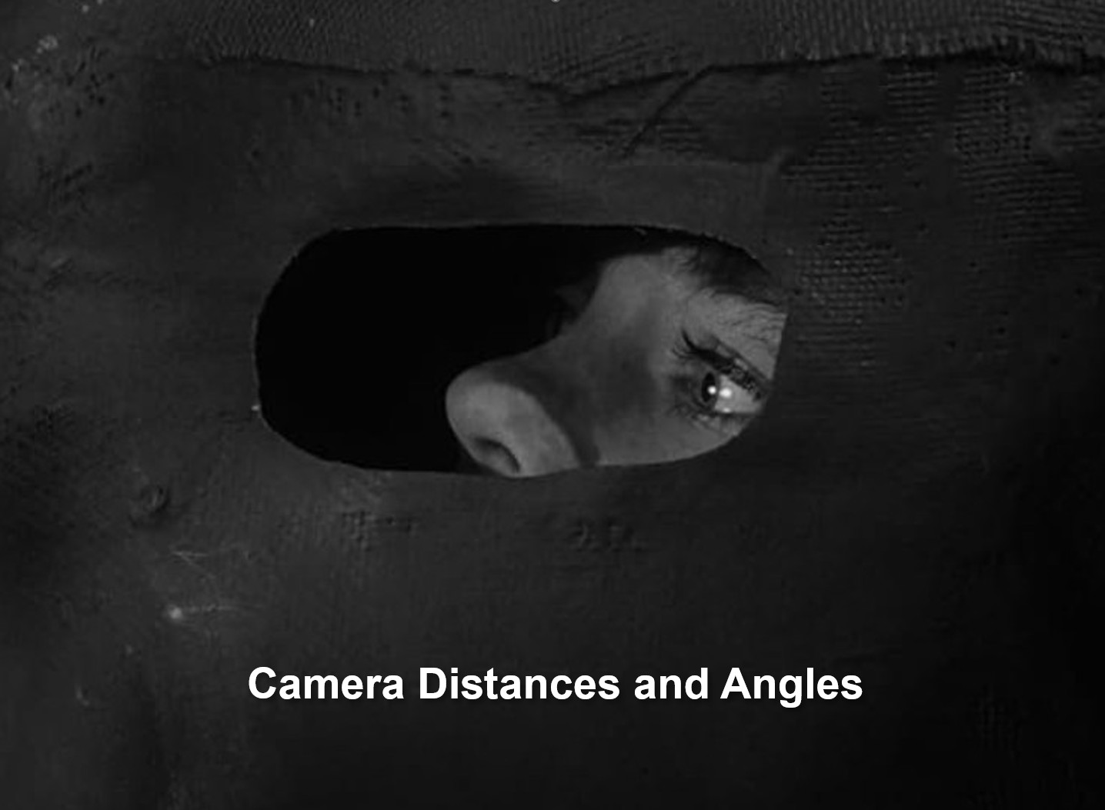

Slide 20
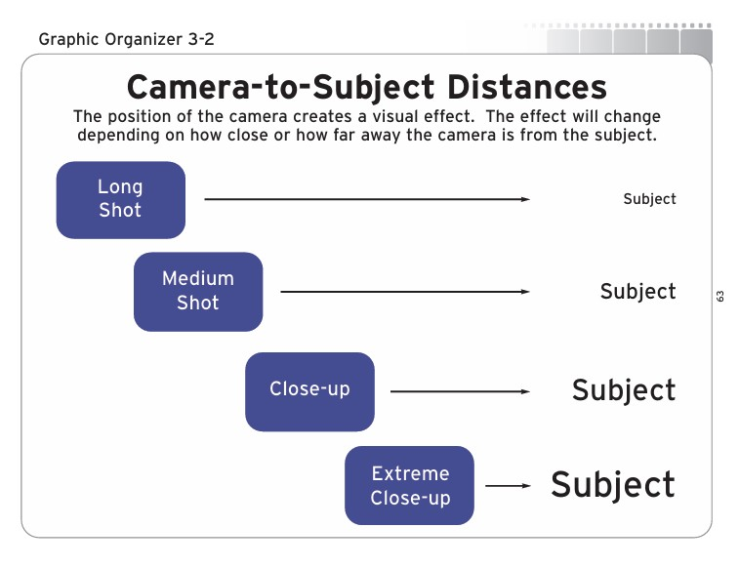
Shots & Significance
CONCEPT: Filmmakers use camera distances and angles to control how an audience views the characters and objects within the frame and to suggest meaning about these characters and objects.

Slide 21
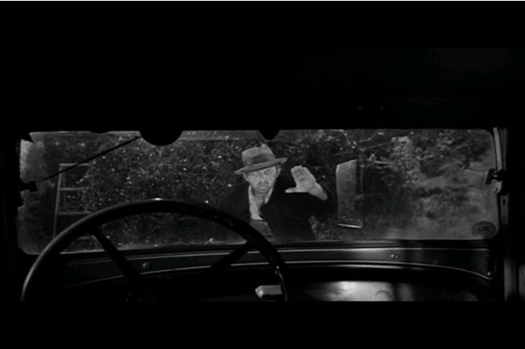
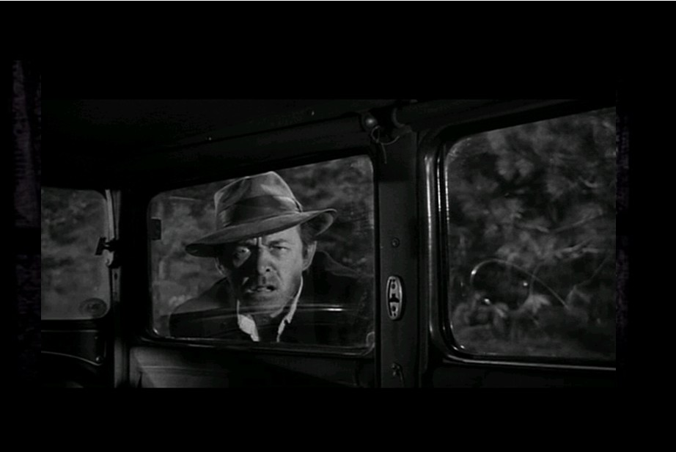
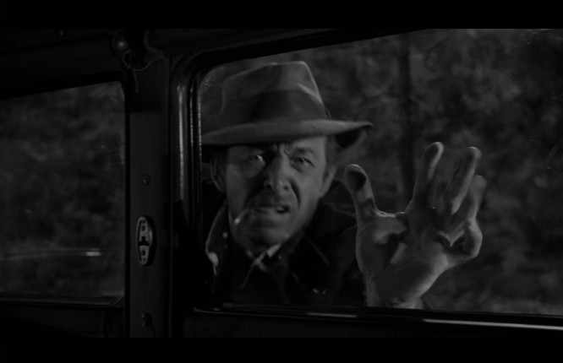
INTERPRETATION. Jem and Scout are in Atticus’s car. By placing the camera inside the car, the viewer sees what Jem sees—Bob Ewell approaching the car.
Ewell is the focal point in each shot, even as the camera distance changes. The medium shot (lower left) and the close-up shot (lower right) allow the viewer to read Ewell’s menacing expression, increasing suspense. The use of low-key lighting also contributes to this effect.

Slide 22
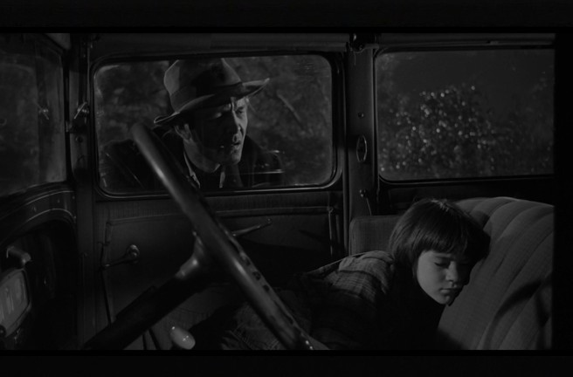
INTERPRETATION. In this medium shot, there are two focal points. Ewell’s face is half in shadow, indicating side lighting on his face. Scout’s face is also illuminated. That means the light source is different for each character, one light coming from the right and the other from the left, allowing us to focus on both characters. Additionally, the diagonal line made by the steering wheel connects the two characters.
Partially shadowing Ewell’s face controls how the audience sees him. He is not clearly revealed, and this underlines that his intentions in this scene are unclear. Does he mean to harm Scout?

Slide 23
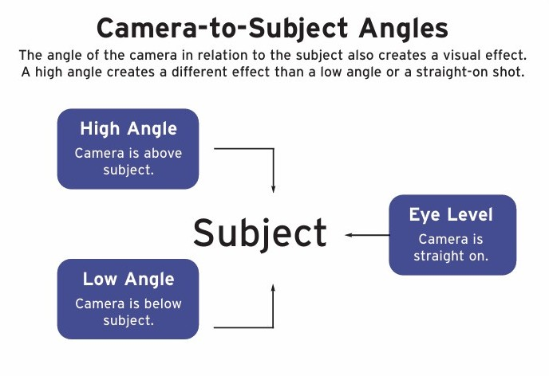
Shots & Significance
CONCEPT: Filmmakers use camera distances and angles to control how an audience views the characters and objects within the frame and to suggest meaning about these characters and objects.

Slide 24
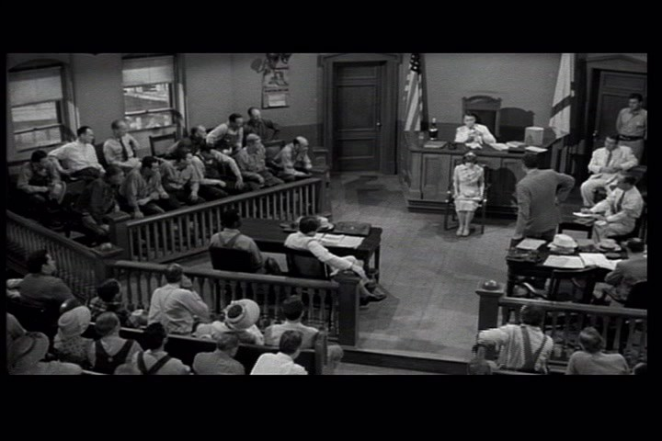
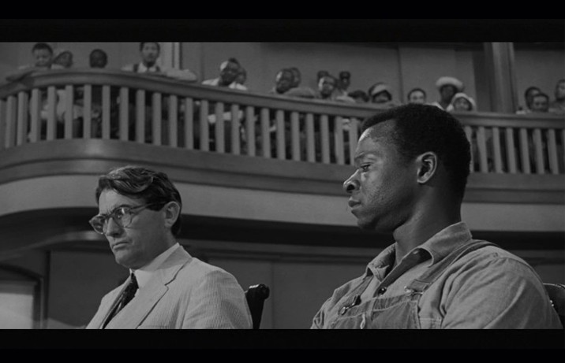
High-Angle and Low-Angle
CONCEPT: In a high-angle shot, the camera placement is above the subject, looking down. This can make the subject appear small, weak, or unimportant. In a low-angle shot, the camera placement is below the subject, looking up, and can make the subject seem impressive or powerful.
Long shot, high-angle
Long shot, low-angle

Slide 25
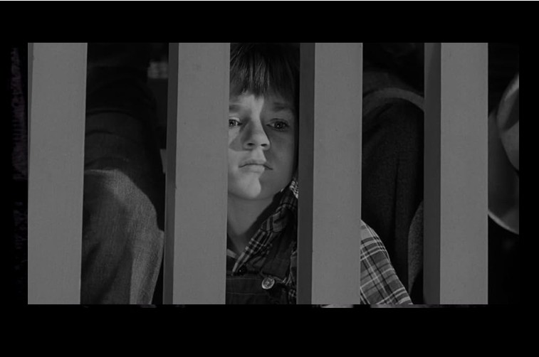
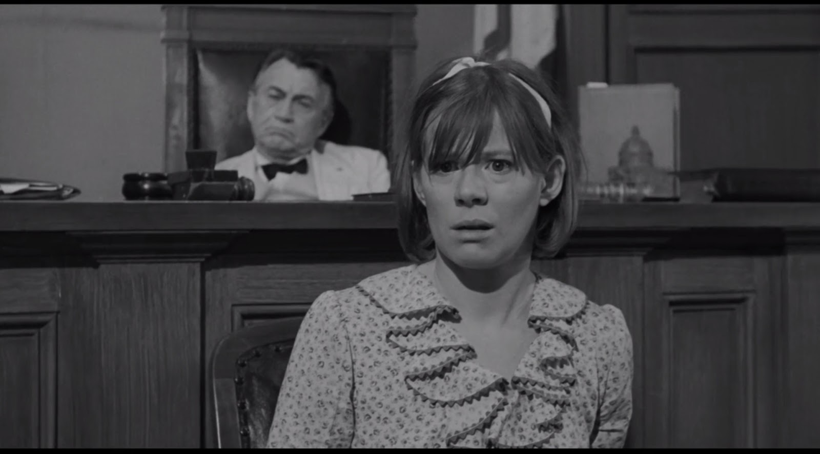
Eye Level
CONCEPT: Framing a subject on eye level, neither high nor low, allows the viewer to look into the eyes of the subject and intuit what they may be thinking or feeling.
INTERPRETATION. Scout sits in the balcony peering through the banister slats at her father in the courtroom below. In this composition, she is “barred” from attending the trial and so sits with the African Americans upstairs.
Mayella has accused Tom Robinson of rape, but this composition suggests she may be feeling doubt or fear about her testimony.

Slide 26
Film composition involves additional elements, but the first step in learning to interpret composition is understanding how filmmakers use the cinematic devices of framing and focal point, lighting, and camera distances and angles to communicate to an audience. Additional elements include, but are not limited to: movement, pacing, and soundtrack.

