Slide 1
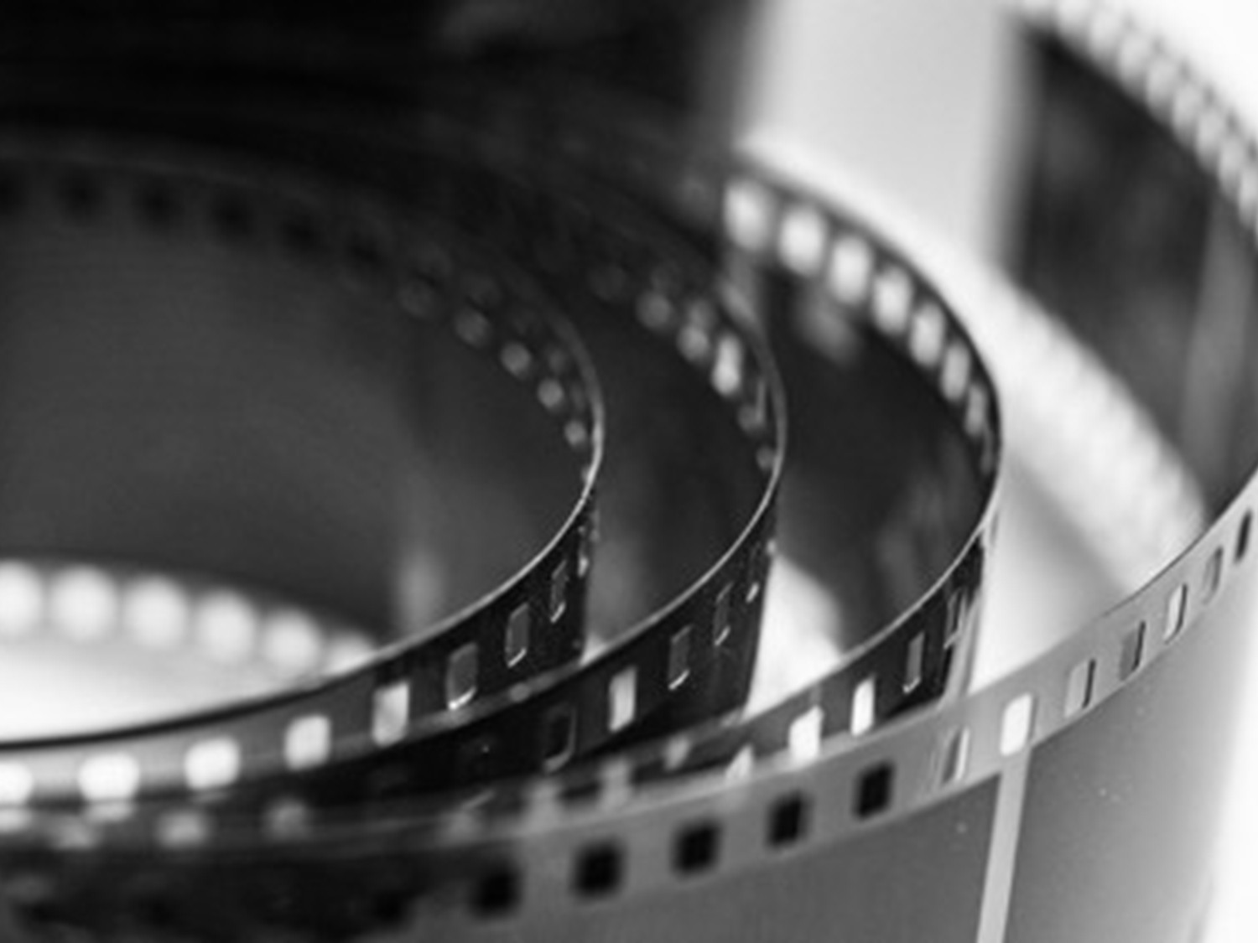
STRATEGIES FOR TEACHING CINEMA LITERACY

Slide 2
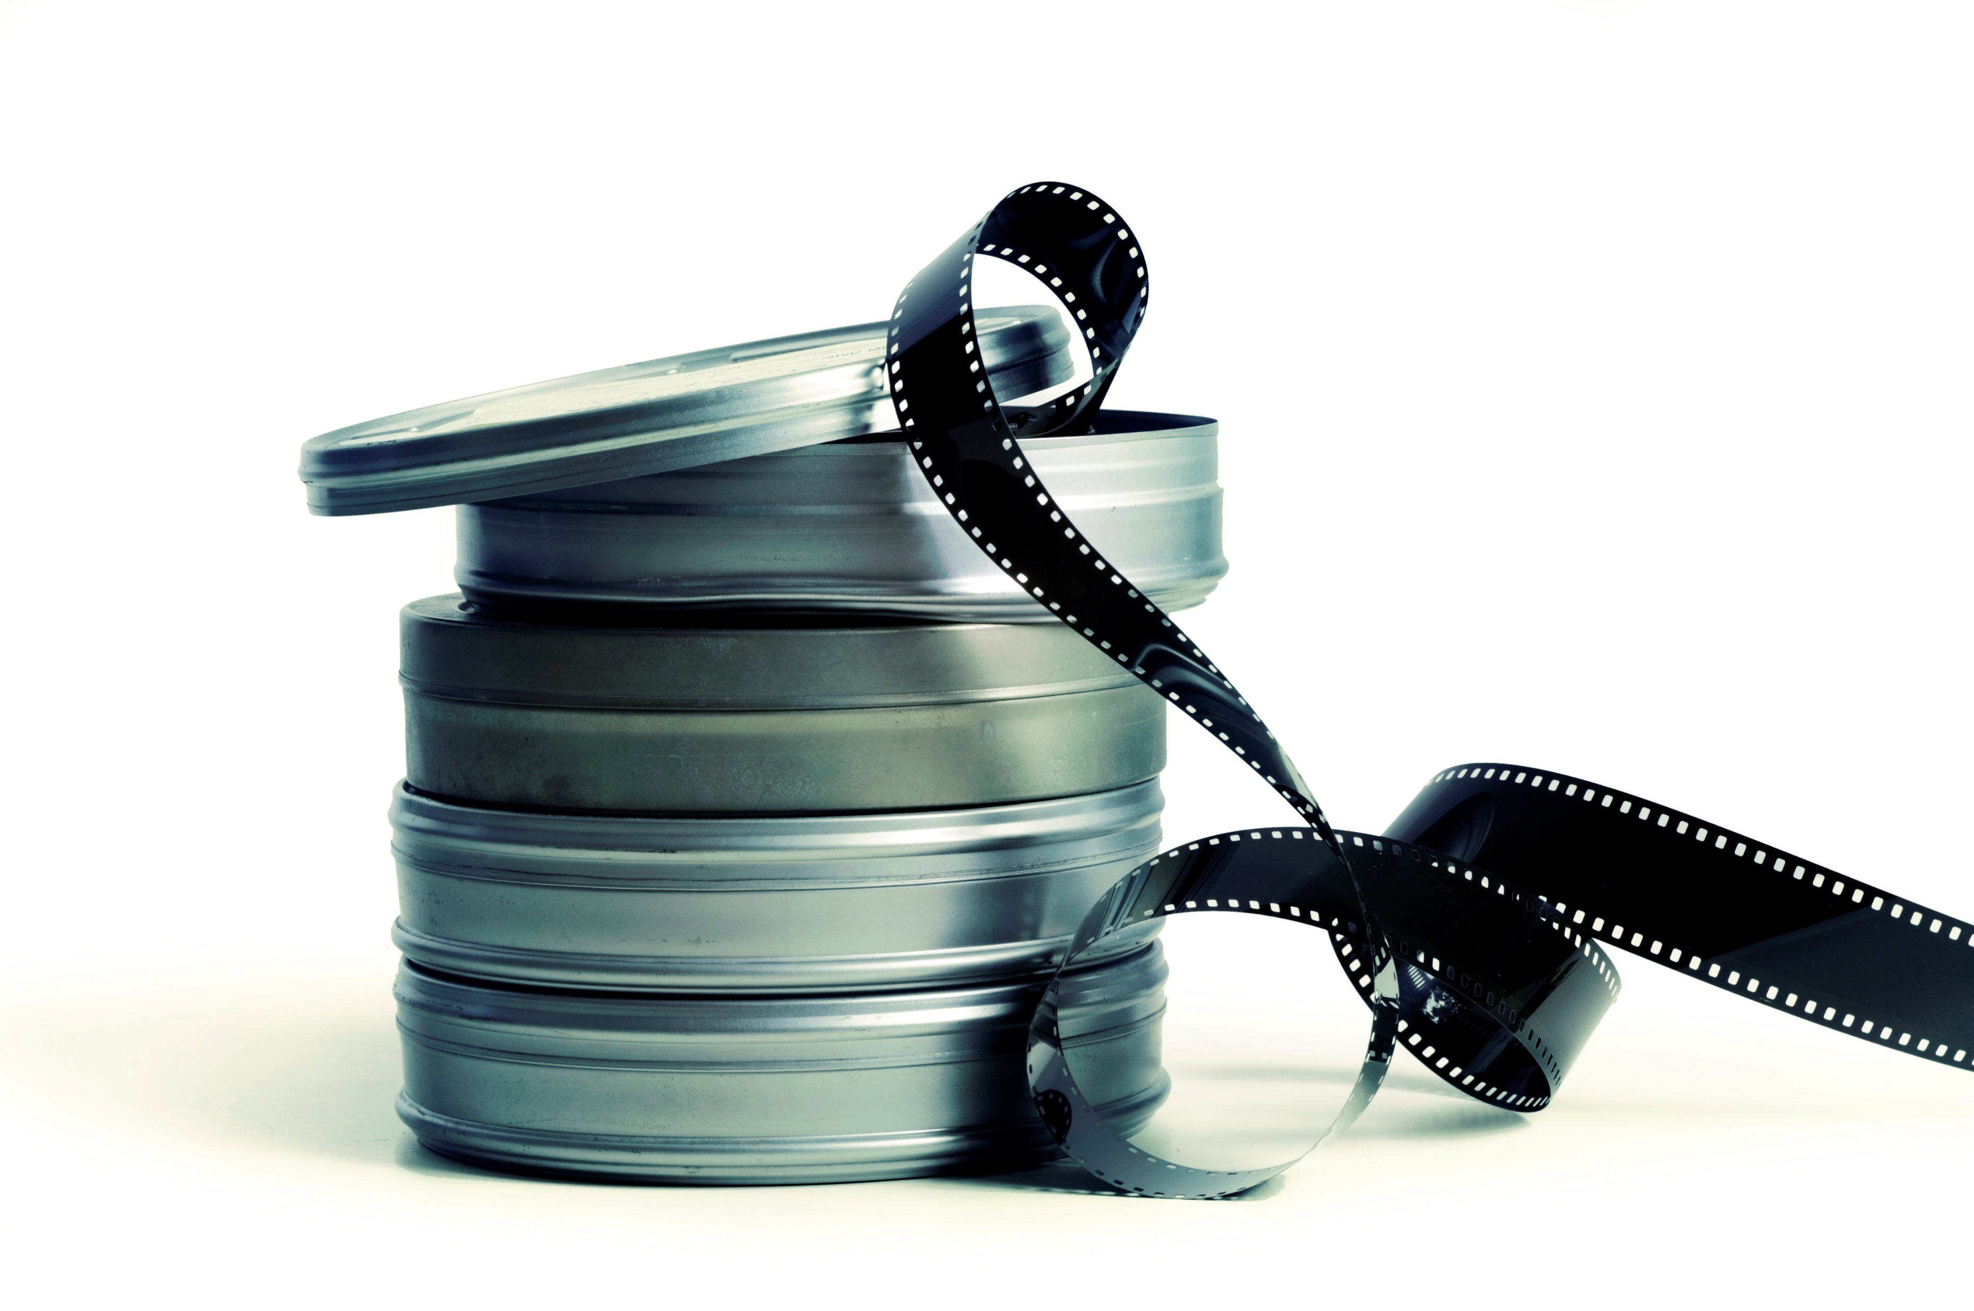
The real question is not whether “Hollywood” movies should be used in the classroom but how and to what ends.
—Teaching History with Film:
Strategies for Secondary Social Studies

Slide 3

Interdisciplinary Approach
Objective: Students tap their existing knowledge of multiple disciplines to interpret the movie.
Narrative focus moves beyond decoding the story to thinking critically about how and why filmmakers create meaning using visual and audio representations.
Film language focus is on cinematic devices rather than literary devices.
Historical/Cultural focus explores the historical period in which a film was made and the social issues relative to the film’s themes.
Aesthetic focus is on film as an art form, its visual design and elements of cinematic style.

Slide 4
The Story of Movies Interdisciplinary Approach
By bringing their existing knowledge to analyzing the movie,
students move from decoding the narrative to exploring the movie’s historical and cultural contexts as well as its aesthetic value.
Music
Literature
History/Social Studies
Science/
Technology
The
Movie
Music

Slide 5
What Are Cinematic Devices??
What Are Cinematic Devices?
Composition
Selection and arrangement of elements
within a single frame of film
Cinematography
Camera distances and angles,
lighting and movement
Pacing & Continuity
Sequence of images, the juxtaposition
and timing of the images
Soundtrack
Sound effects, dialogue, and music

Slide 6
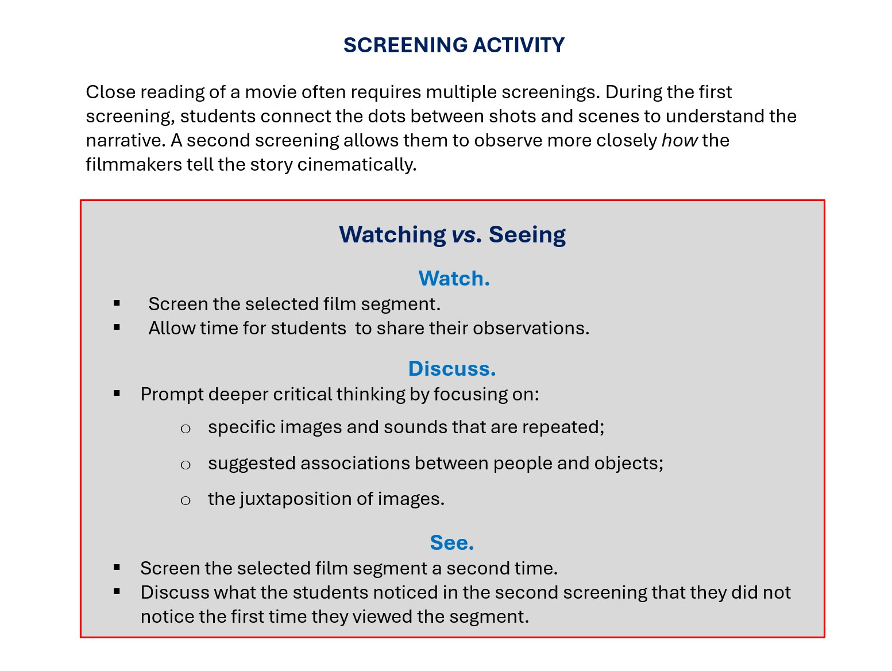

Slide 7
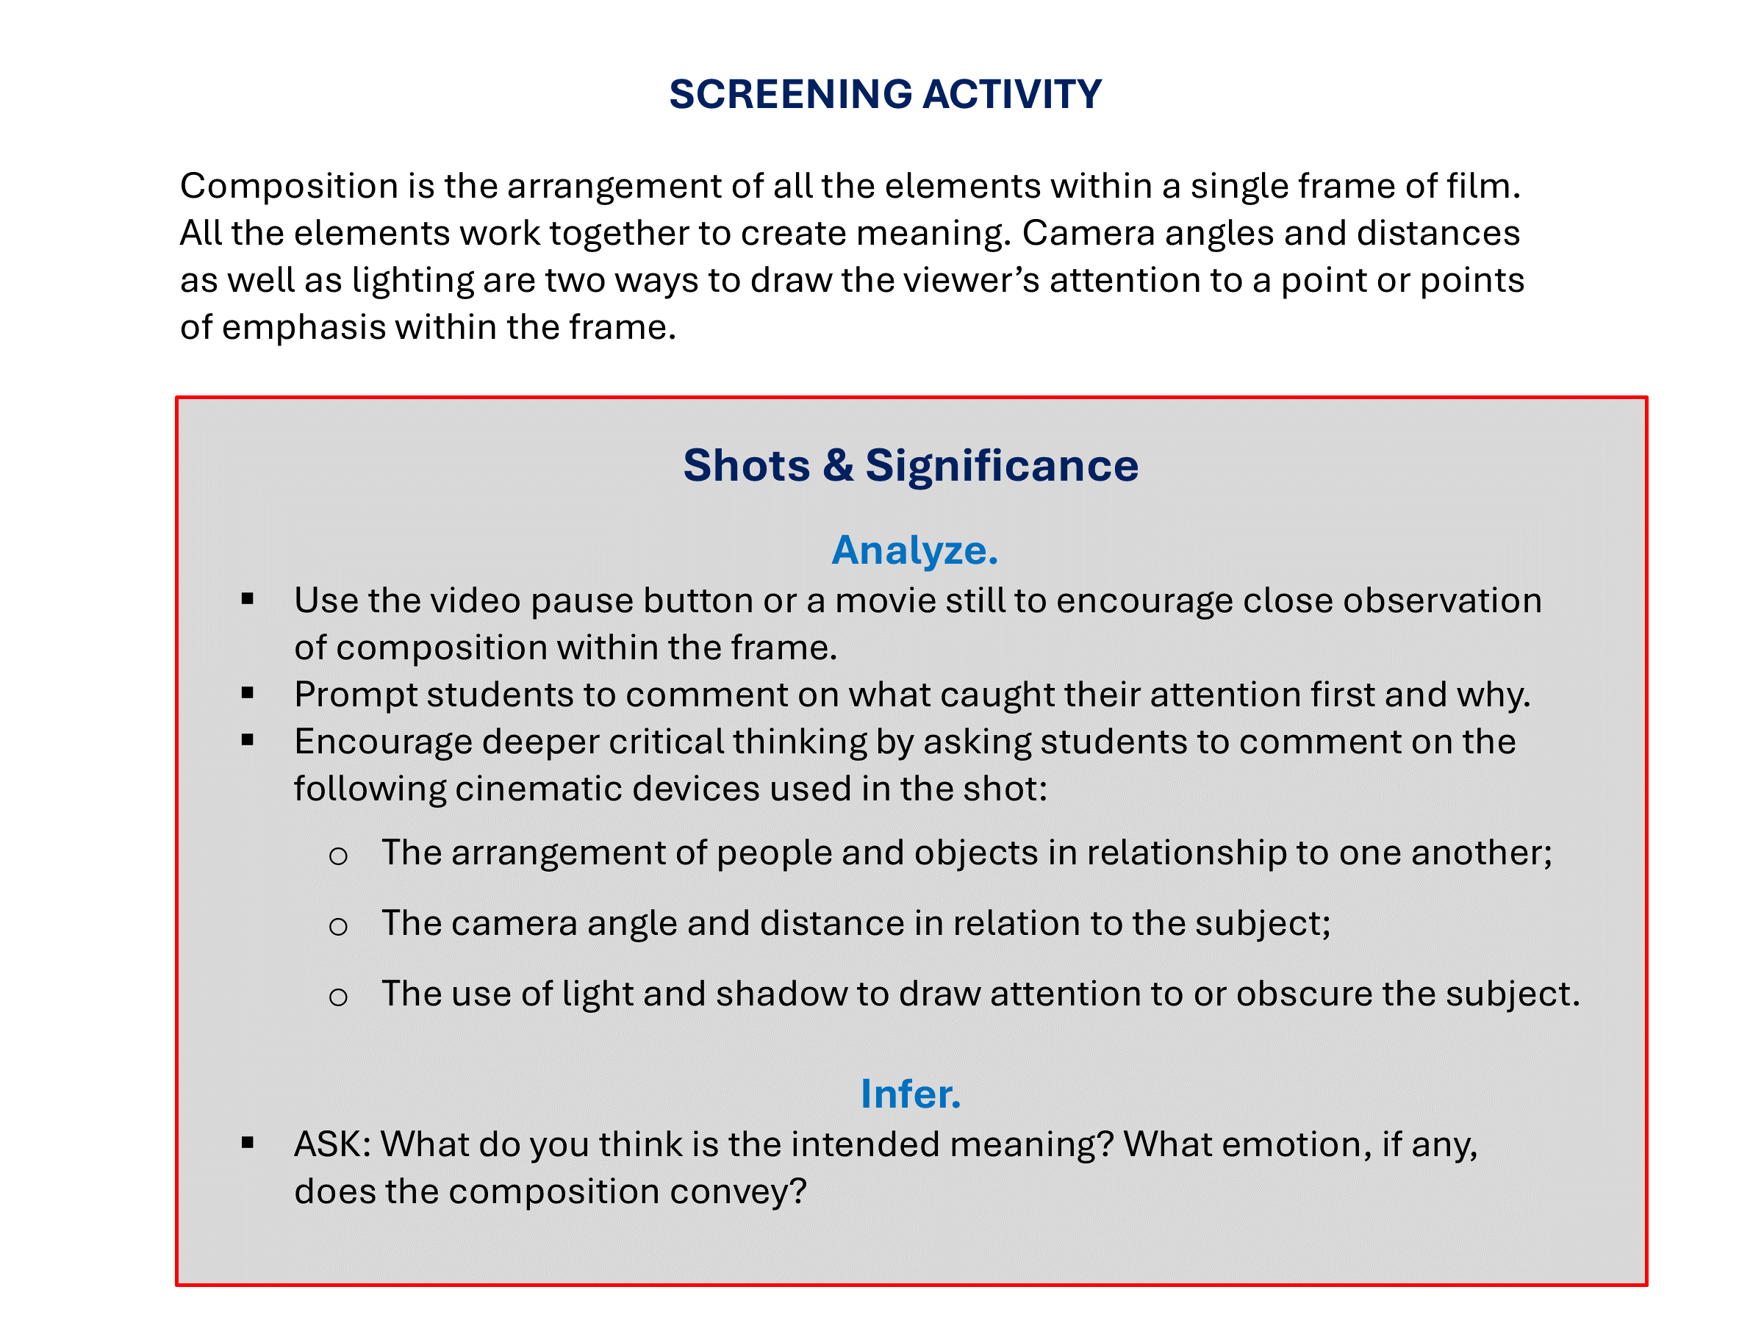

Slide 8
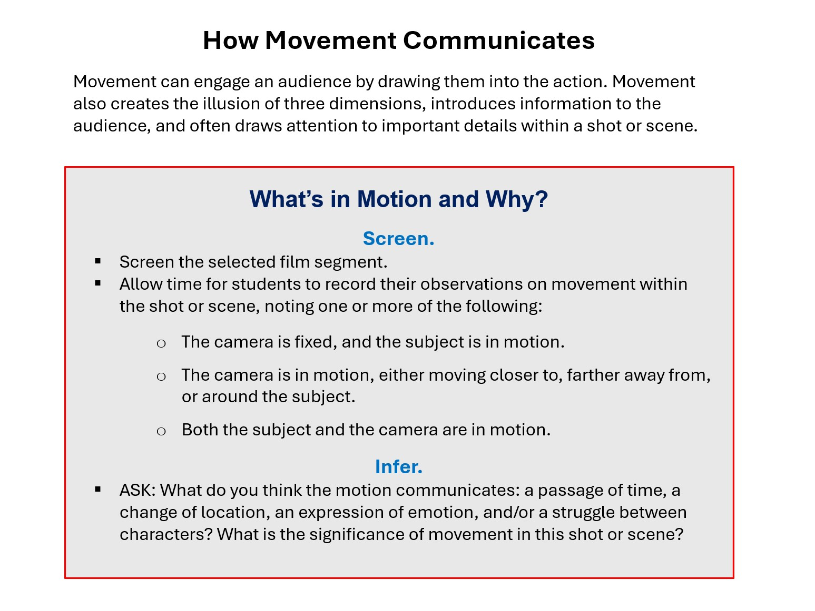

Slide 9
How Music Communicates
Music has distinct functions: to convey information, suggest meaning, and evoke an emotional response in the audience.
5 Principles of Music Composition
Rhythm
Patterns and duration of sounds
Tempo
The pace or timing of the music
Dynamics
Strength and degree of volume
Pitch
Highness or lowness of sound
Timbre
Color or quality of sound, the resonance determined
by the type of instrument being played

Slide 10
SCREENING ACTIVITY
The soundtrack includes sound effects, dialogue, and musical score. While students’ focus is often primarily on dialogue, additional elements of sound design can influence how they perceive the characters and the situations.
Ears and Eyes
Eyes Only
Screen the selected film segment without the soundtrack.
ASK: What did you see?
Allow time for students to record and share their observations about the images, actions, and/or emotions conveyed.
Ears Only
Re-screen the same film segment without images, just the soundtrack.
ASK: What did you hear?
Again, allow time for students to record everything they heard—sound effects, dialogue, and music. Prompt discussion about the volume and tone of the sounds.
Eyes & Ears
Screen the film segment a third time, with both soundtrack and images.
ASK: How do the visual and sound design work together to create meaning?

Slide 11
What Is Mise-en-Scène?
Mise-en-Scène is a type of analysis in which the student identifies elements of composition in a single scene, explaining how all the elements work together to communicate mood and meaning.
Because Mise-en-Scène requires students to read various cinematic elements—pulling away layers of meaning in the scene—this activity is good for team or group work.
When writing a Mise-en-Scène analysis, students apply their knowledge of film language terminology. Their focus is on the use of cinematic devices. This includes, but is not limited to: cinematography, production design, editing, and soundtrack.

Slide 12
SCREENING ACTIVITY
Close reading of a movie often requires multiple screenings. During the first screening, students connect the dots between shots and scenes to understand the narrative. A second screening allows them to observe more closely how the filmmakers tells the story cinematically.
Mise-en-Scène
Watch and Record.
Screen the selected film segment.
Re-screen the segment, allowing time afterwards for students to record their observations on the use of the following cinematic devices:
Camera Distances and Angles
Lighting
Camera Movement
Soundtrack
Discuss.
ASK: What information is communicated explicitly?
ASK: What information is communicated implicitly?
ASK: What can you infer about the characters and/or the situations based on the use of cinematic devices?

Slide 13
SCREENING ACTIVITY
All films are representations of social reality, at times mirroring and at other times distorting society. Like all visual images, film depictions have connotations that can be positive, negative, or neutral. In this activity, students apply their knowledge of cinematic devices to interpret the connotation of a depiction.
SCREENING ACTIVITY
Interpreting Depictions
Identify the Depiction
Screen the film segment. It may be necessary to screen the segment a second time for students to observe and comment on the following cinematic techniques:
Appearance —costuming, hairstyle, makeup;
Acting—body language and expressions;
Dialogue—what is spoken and how, as well as what is not spoken;
Framing and composition—camera angles and distances, lighting.
Infer.
Prompt discussion on whether students feel the depiction is positive, negative, or neutral, based on the points above, encouraging them to explain their response.
ASK: What do you believe was the filmmakers’ purpose in creating the depiction in this way? What do the filmmakers want you to think or feel about this subject?

Slide 14
Historical and Cultural Contexts
Time & Interpretations
When interpreting a film, students should be able to distinguish between past and present and to identify historical and cultural events relative to the film.
The key question to ask is not what part of history did the filmmakers get right or wrong. Rather, encourage historical inquiry by having students investigate social issues that may have influenced not only the filmmakers but the audiences at the time the movie was made.
Historical period in which the film is created
Historical period in which the film is seen
Historical period in which the film is set

Slide 15
SCREENING ACTIVITY
Films are reflections of the cultural and historical periods in which they were made. Studying the period in which a film was made provides insight to social concerns that may have influenced the filmmakers. Audiences viewing a movie in the present day may have different values and sensitivities than audiences at the time the movie was made and first released in theaters.
SCREENING ACTIVITY
Time & Interpretations
Research.
Students identify historical events and people relative to the movie’s setting and/or period of production.
Infer.
Students analyze the movie’s overall themes and depictions to determine how, if at all, the filmmakers were influenced by the historical/cultural events related to the movie’s setting and/or period of production.
Present.
Students argue the key historical and cultural events that influenced how the filmmaker told the story. This includes, but is not limited to, production design and costuming and the actors' performances.

