Slide 1

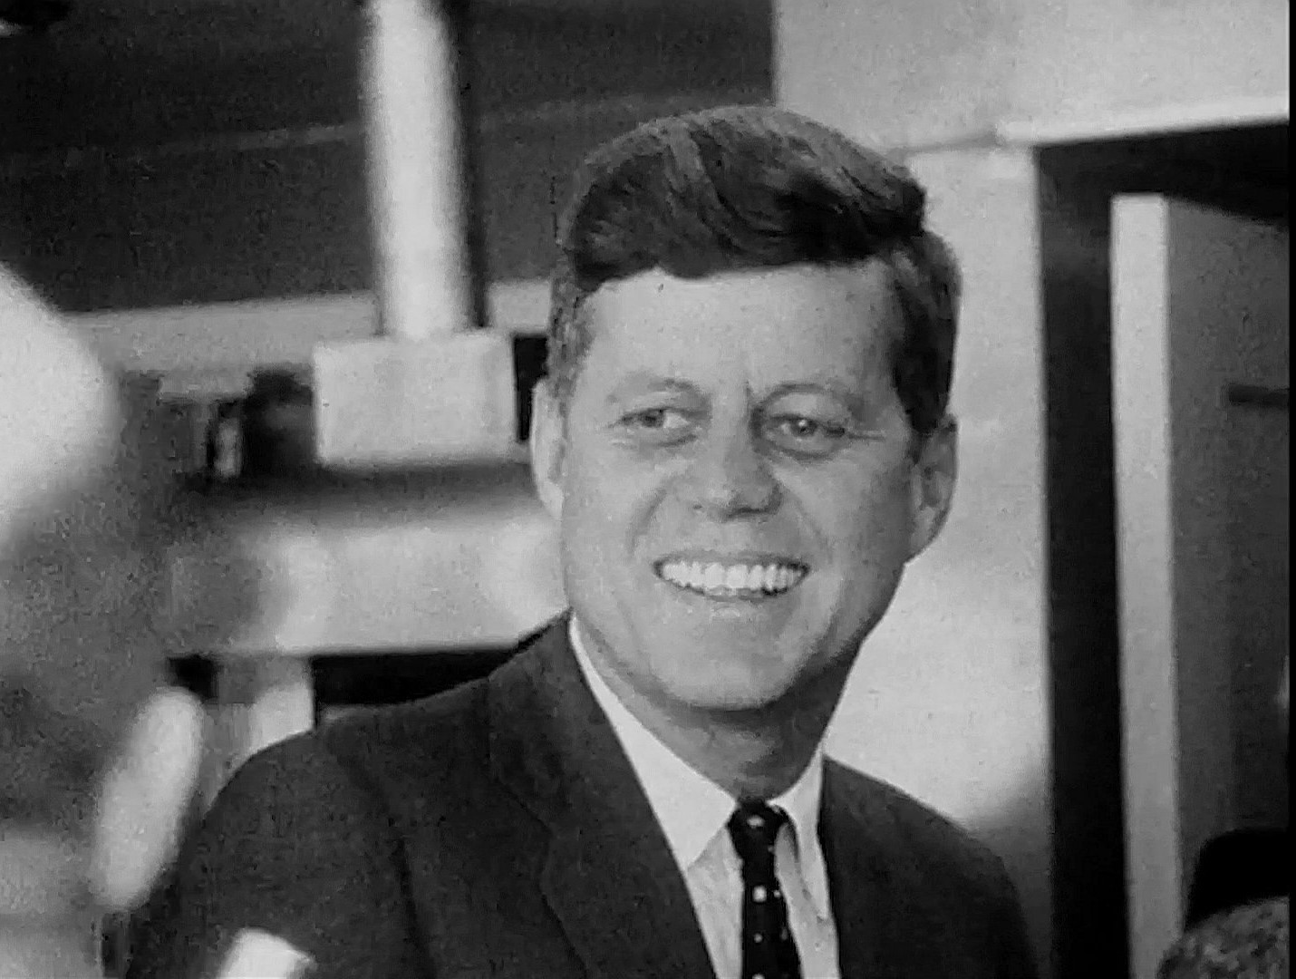
Cinema Verité: Filming John F. Kennedy

Slide 2
How Do Filmmakers Create Depictions?
FRAMING AND COMPOSITION. The arrangement of people and objects within the frame suggest meaning.
CAMERA ANGLES AND DISTANCES. Camera placement determines how the viewer sees the subject.
LIGHTING. The light source and its intensity determines how the viewer perceives the subject.
MOVEMENT. Movement of both the camera and/or the subject within the frame suggests meaning.
ACTION AND REACTION SHOTS. A character’s behavior and how other characters react to that behavior suggests meaning.
SOUNDTRACK. Dialogue (both what is said and how a line is delivered), sound effects, music, and silence all suggest meaning.
Notes:
ASK: What is the intended effect of the depiction? Cinematic depictions, like words and other visual images, have connotations or shades of meaning. The resulting effect of the depiction may be positive, negative, or neutral.

Slide 3
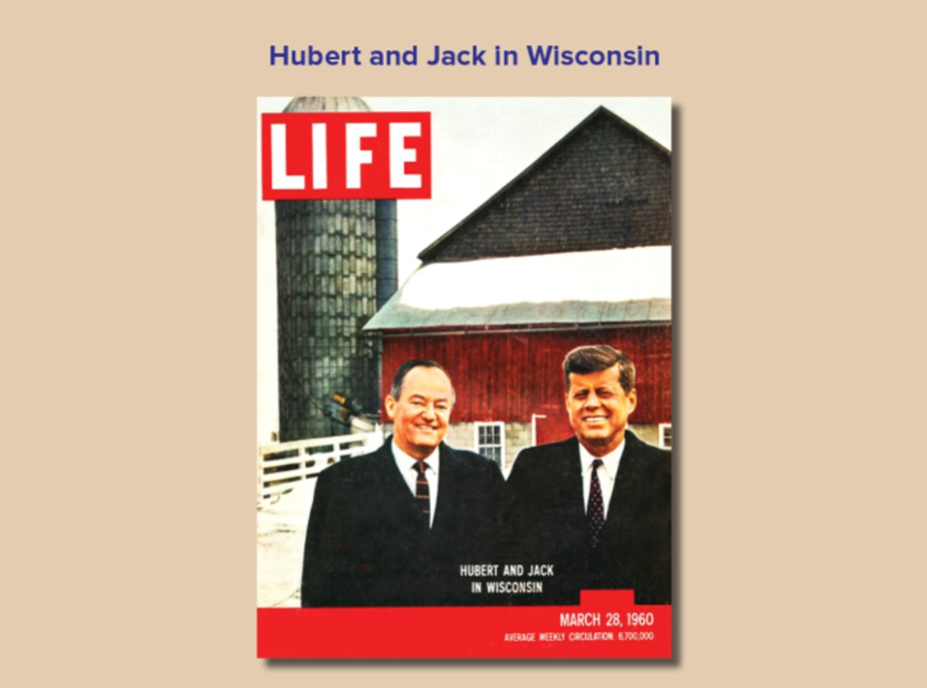

Slide 4
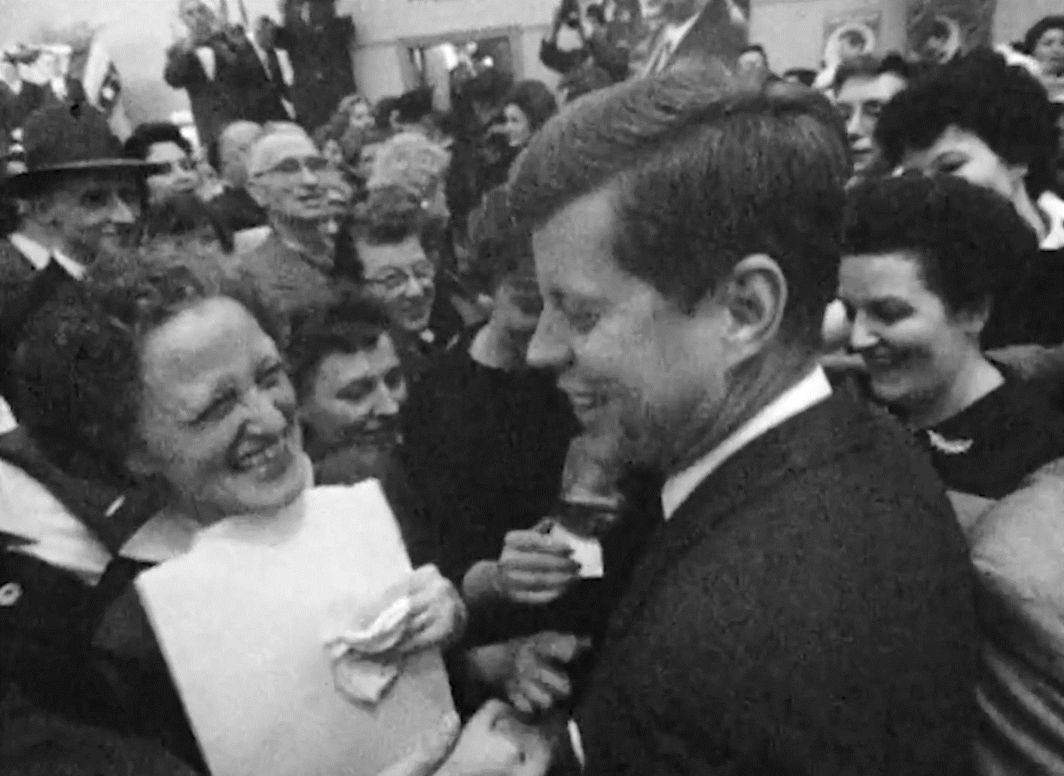
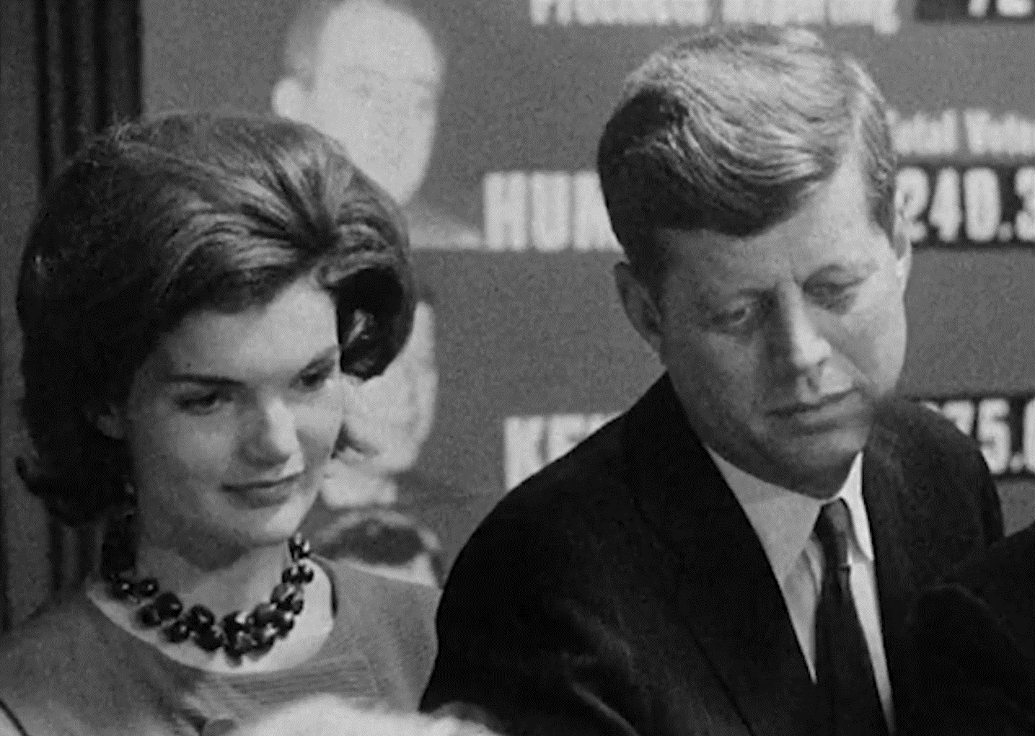
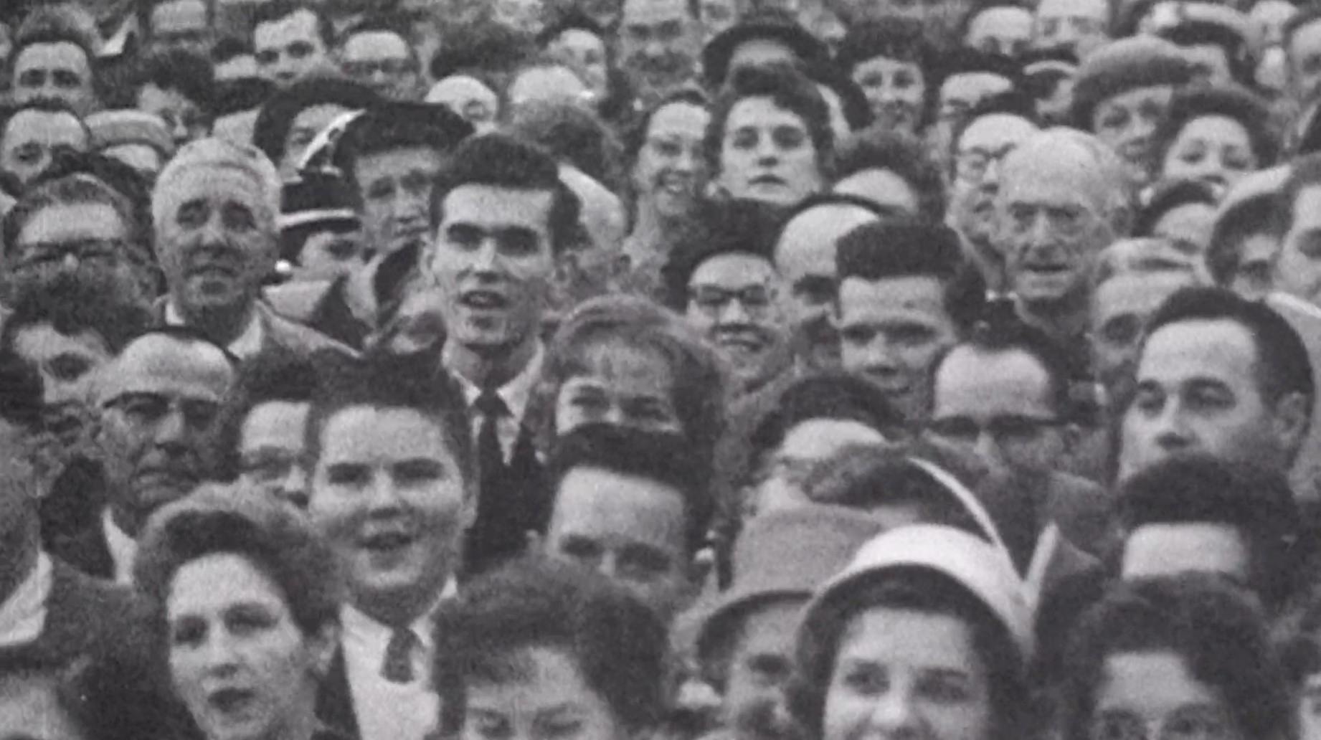
Shots and Significance

Slide 5
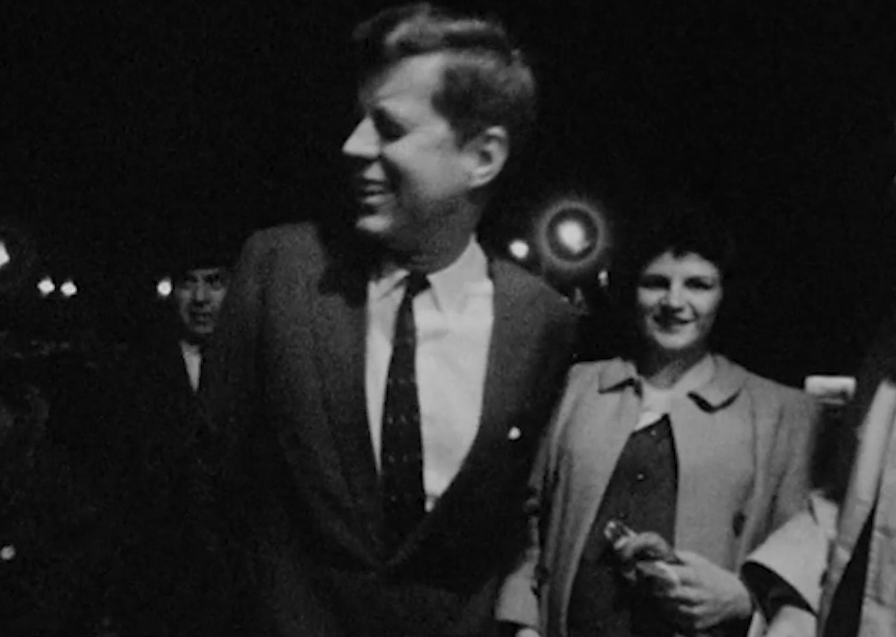
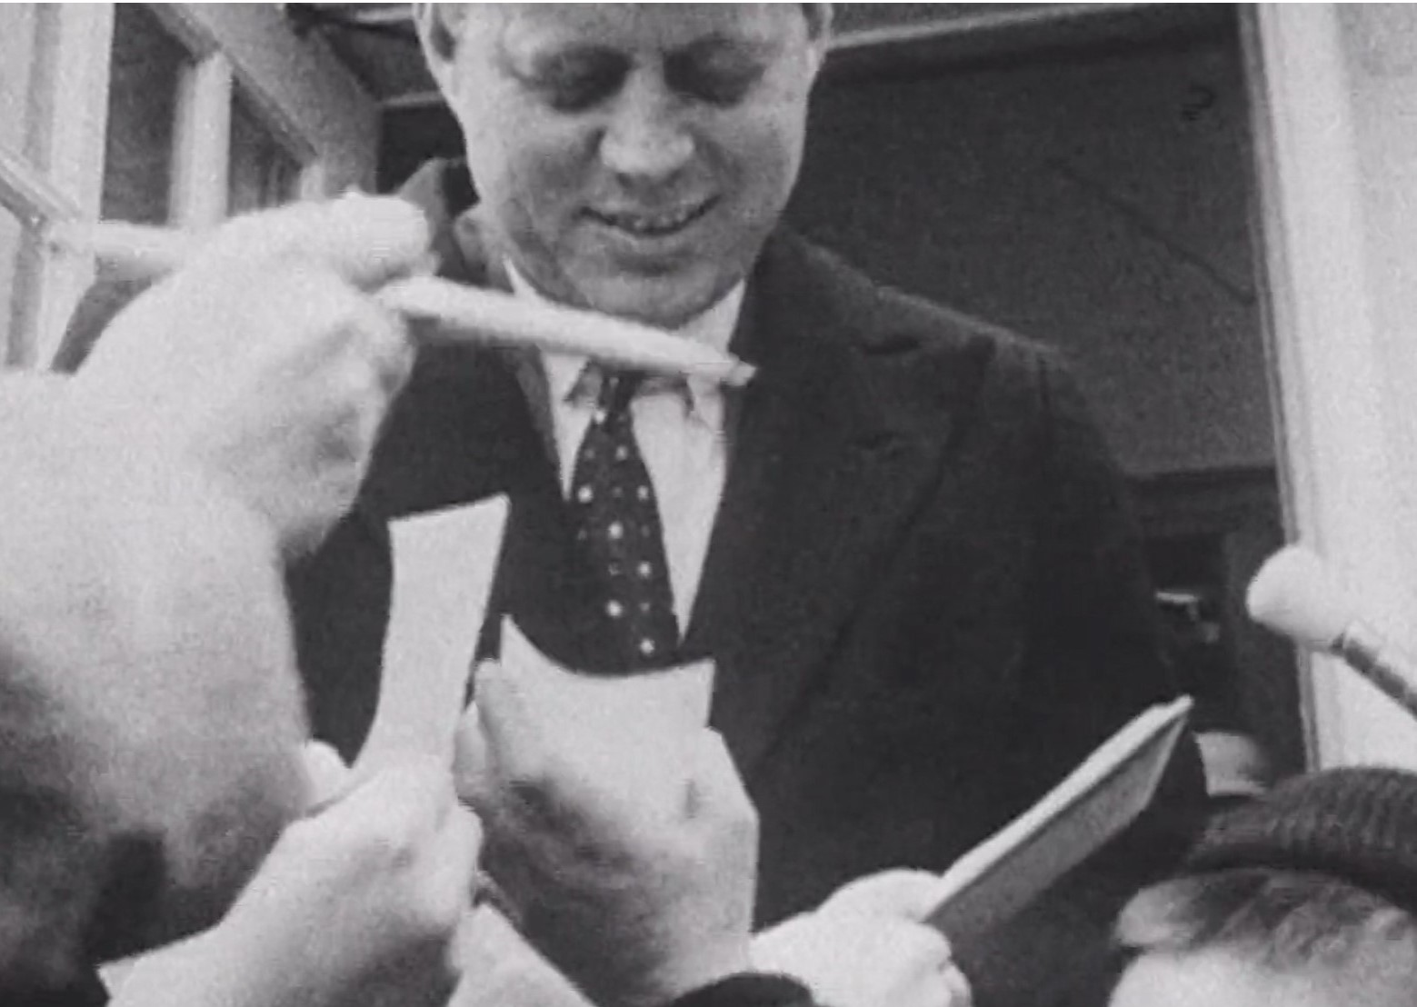
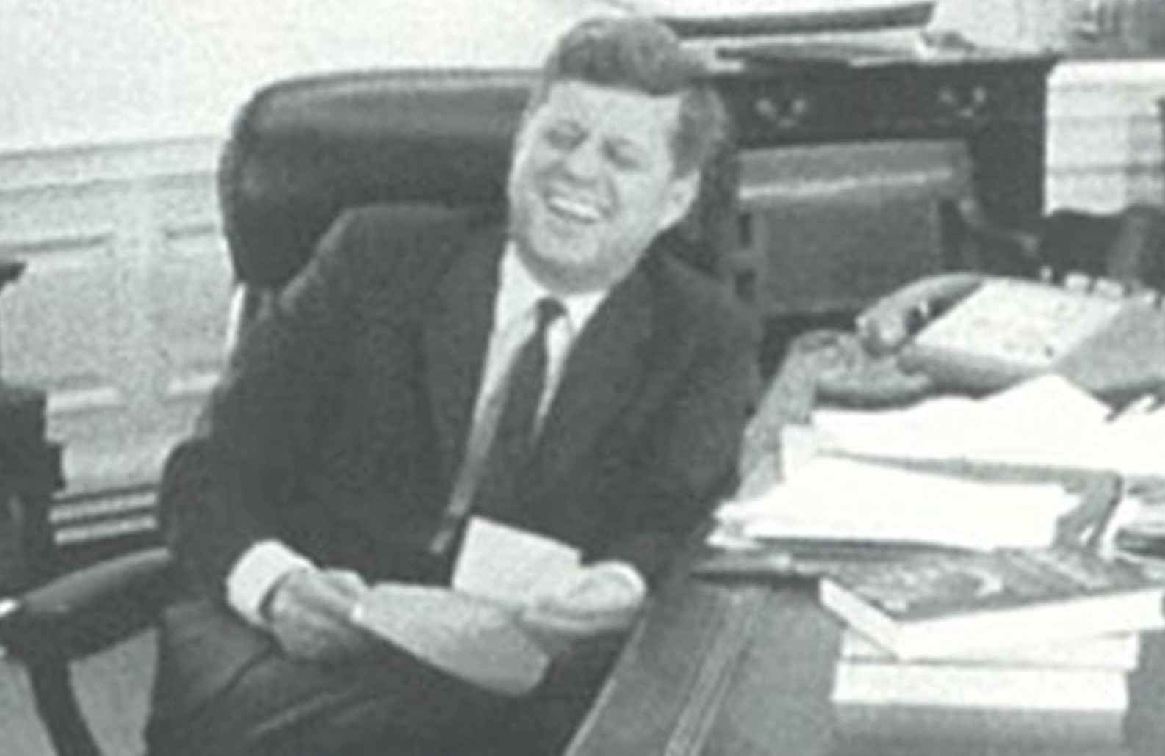
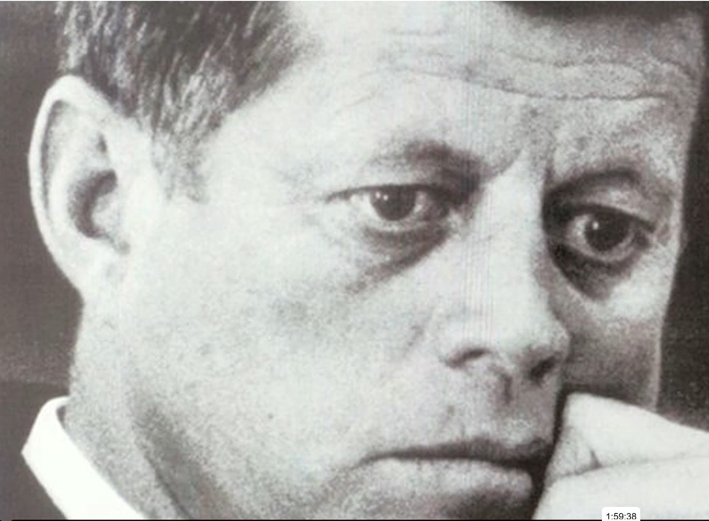
Robert Drew Films JFK

